Slide 1



Credit Card Financial report
View in Power BI
Last data refresh:
22/08/2024 00:08:26 UTC
Downloaded at:
22/08/2024 00:16:21 UTC

Slide 2
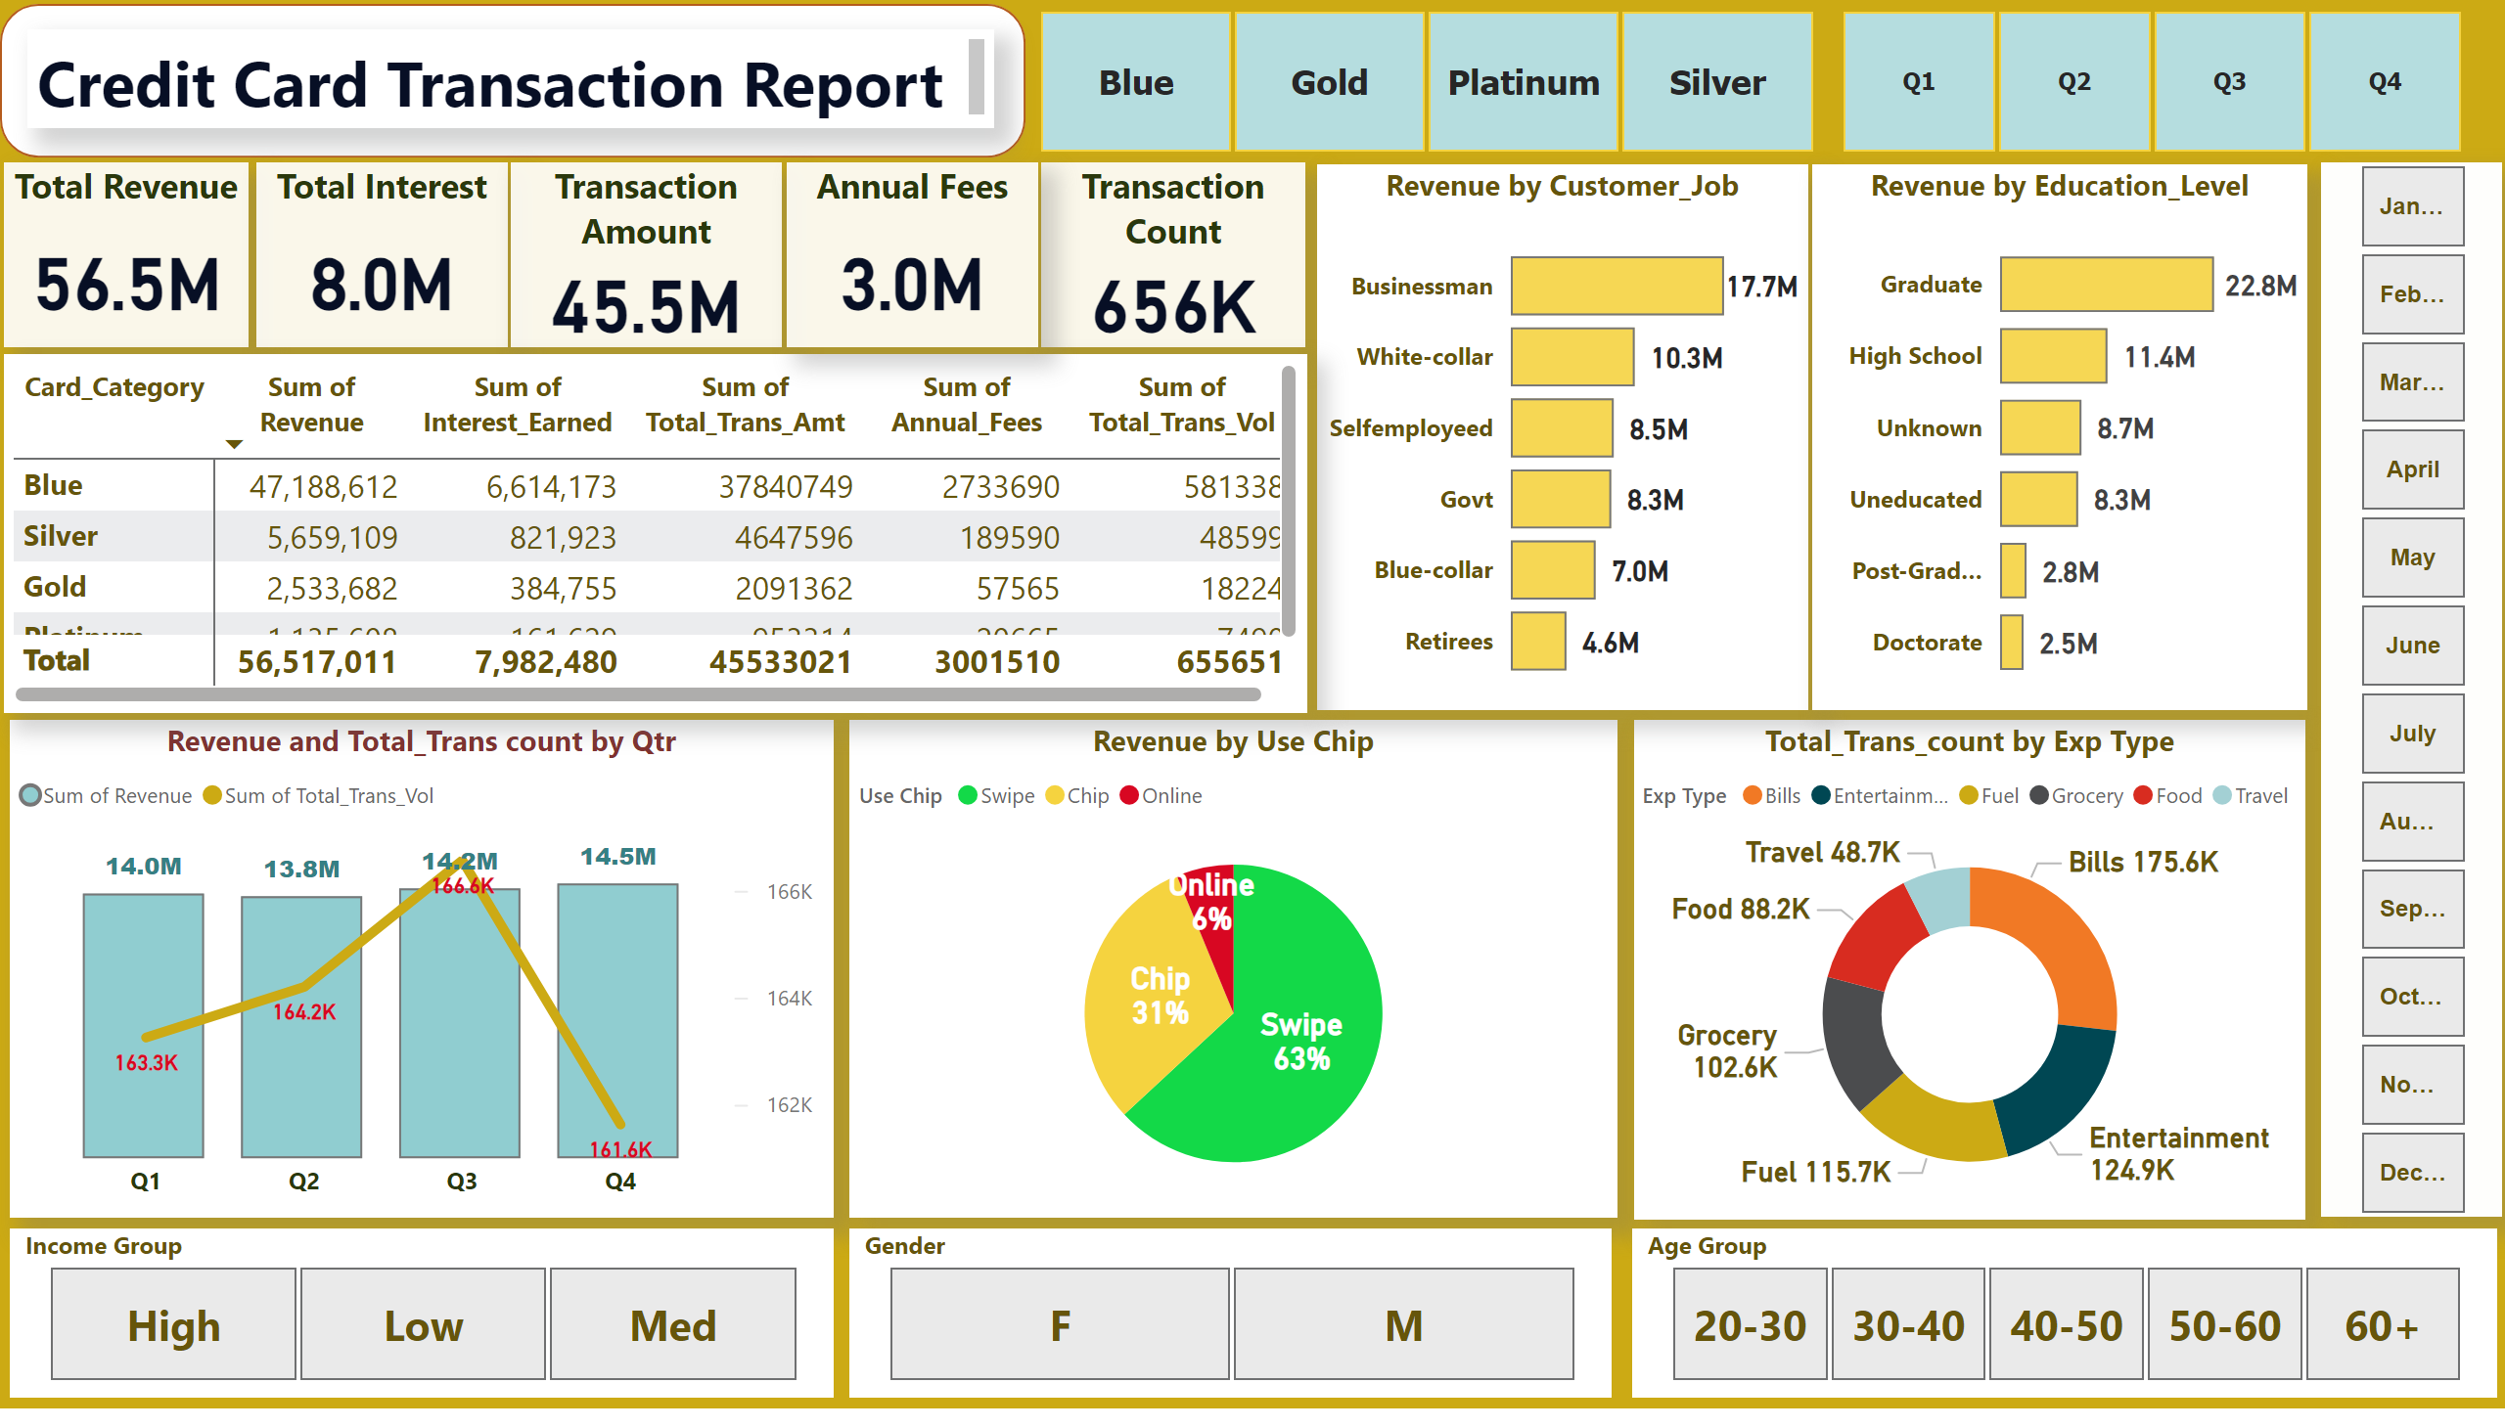
Credit Card Transaction Report
Notes:
shape
No alt text provided
textbox
No alt text provided
Total Revenue
No alt text provided
Total Interest
No alt text provided
Transaction Amount
No alt text provided
Transaction Count
No alt text provided
Revenue and Total_Trans count by Qtr
No alt text provided
Revenue by Use Chip
No alt text provided
Total_Trans_count by Exp Type
No alt text provided
Revenue by Customer_Job
No alt text provided
Revenue by Education_Level
No alt text provided
pivotTable
No alt text provided
Annual Fees
No alt text provided
slicer
No alt text provided
slicer
No alt text provided
slicer
No alt text provided
slicer
No alt text provided
slicer
No alt text provided
slicer
No alt text provided

Slide 3
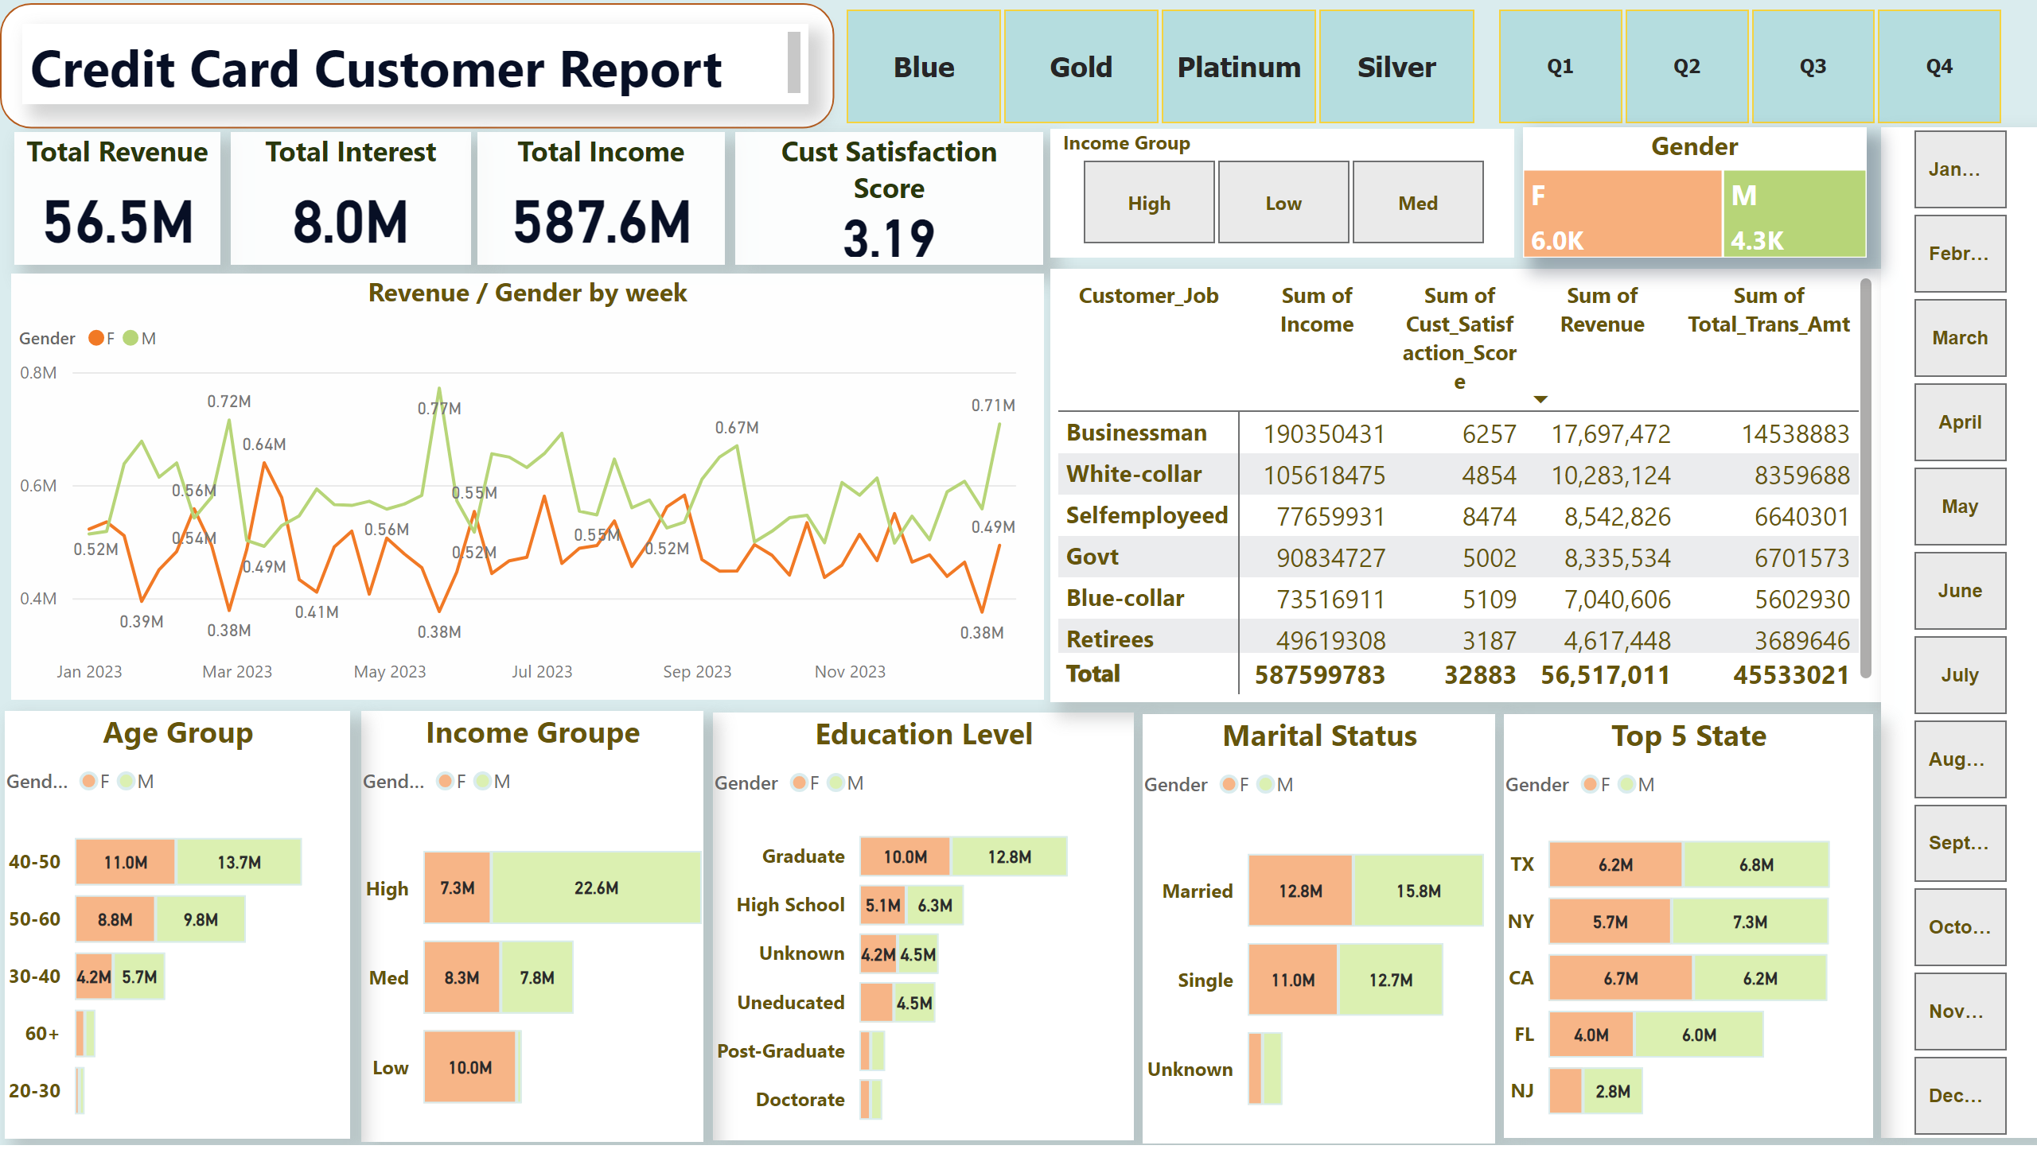
Credit Card Customer Report
Notes:
shape
No alt text provided
textbox
No alt text provided
Total Revenue
No alt text provided
Total Interest
No alt text provided
Total Income
No alt text provided
Cust Satisfaction Score
No alt text provided
Education Level
No alt text provided
pivotTable
No alt text provided
slicer
No alt text provided
slicer
No alt text provided
slicer
No alt text provided
slicer
No alt text provided
Marital Status
No alt text provided
Income Groupe
No alt text provided
Age Group
No alt text provided
Top 5 State
No alt text provided
Revenue / Gender by week
No alt text provided
Gender
No alt text provided

